Slide 1
Cancer Biology Biol 445
Spring 2020
Dr. Heidi Super
Lecture 22
3-27-2020

Slide 2
Where were we? Pathogens (viruses, bacteria, parasites) and cancer
Acutely transforming viruses
Slowly transforming viruses
Viruses with indirect links to cancer
Immunosuppressing virus
EBV
HIV
Chronic infections leading to chronic inflammation
Hepatitis B and C viruses

Slide 3
Chronic infections…
Call in immune system cells to the damaged tissue.
Visible with PATHOLOGY techniques.
Hepatitis B and C viruses---example

Slide 4
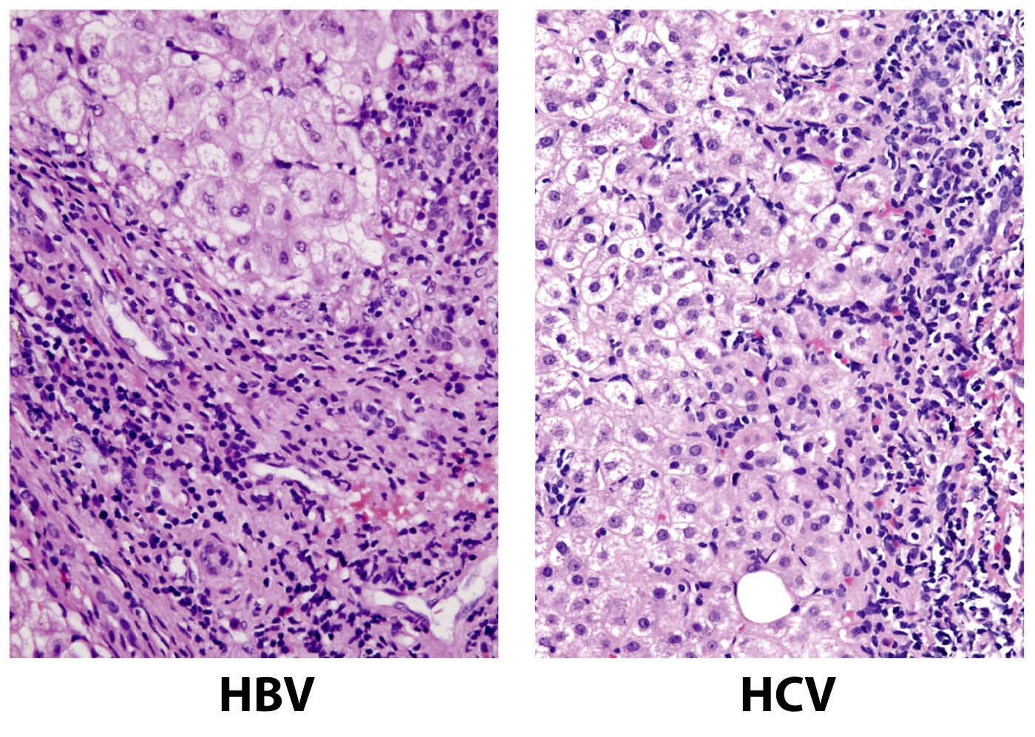
Hepatocytes
Lymphocytes
Hepatocytes
Lymphocytes
Figure 11.35b The Biology of Cancer (© Garland Science 2007)

Slide 5
How do HBV/HCV cause cancer?
1. Establishing long term, chronic infection
2. Infection directly damages tissue. Uninfected cells stimulated to proliferate. Anything that increases cell proliferation, increases the chance for acquiring mutations.

Slide 6
3. Tissue damage triggers immune response.
Infiltration of lymphocytes and macrophages.
These WBCs act in 2 ways to contribute to cancer.
A. Release cytotoxic chemicals such as oxygen free radicals. Kill pathogens, but also act as mutagens. With increased proliferation, increases the chance that new tissue cells will acquire DNA damage
B. Release factors such as NF-kappa B, which activates transcription of genes that stimulate cell division and inhibit apoptosis.

Slide 7
Chronic infections with HVB and HVC set up conditions which increase the likelihood that multiple mutations occur in the same liver cell.

Slide 8
More cancer links to inflammation…
Stomach cancer---Linked to ulcer-causing bacterium Heloicobacter pylori.
~50% infection world-wide.
Stomach cancer requires prior exposure to H. pylori.
Stomach cancer 2nd only to lung cancer incidence world-wide
Elimination of H. pylori with antibiotics greatly reduces stomach cancer incidence.
Specific diets (high salt) greatly increase stomach cancer incidence

Slide 9
Mechanism?...
Same as HBV/HBC in some aspects
General effect of cell damage, infiltration of immune system cells.
-More specific mechanism—expression of H. pylori protein called CagA. CagA stimulates cell division in epithelial cells of stomach lining.

Slide 10
Flatworm infections
Blood flukes and liver flukes (tremotodes)
Blood flukes carried by fresh water snails---cause shistosomiasis ---common in Africa, South America
Bathing in water with high snail count allows larvae to enter skin. Worms mature and live in bladder and intestine. Chronic infection/inflammation.
Blood fluke infection linked to bladder cancer.

Slide 11
Liver Fluke
Contract by eating raw or undercooked fish.
Parasite lives in bile ducts of the liver and induces inflammation there.
Linked to rare bile-duct cancer (common in regions of Asia, where liver fluke common).Linked to the diets of that population.

Slide 12
Pause…
Let’s reflect---We’ve studied aspects of cancer in which we know the immune response is important for limiting cancer incidence.
Name TWO pieces of evidence you’ve seen that support this…
In fact one of the most recent approaches to cancer treatment is preventing the natural block cancer cells can put on the hosts immune system. (See upcoming slides).

Slide 13
And yet…Chronic infection with viruses, bacteria, and parasites stimulates an immune response---inflammation, part of what is called the innate immune response.
Inflammation is an early normal event in a good immune response, but it should lead to a second phase of responses---Called adaptive immune response, which is designed to clear the infection entirely.

Slide 14
Some pathogens outwit the immune response by eliciting a strong early response (which almost always includes inflammation) but which inhibit a strong adaptive response.
This is how chronic infection is maintained.
Its how the Spanish Flu of 1918 killed so many.
It’s likely why COVID-19 is so deadly.

Slide 15
When it comes to cancer, which is correct?
Immune response bad!
Immune response good!

Slide 16
Let’s return to concepts we visited a while back, regarding ”good” immune responses toward cancer cells.

Slide 17
Why isn’t the immune system better at protecting us from cancer?
Unknown? Not any more!
Some tumor antigens may be expressed rather late in tumor progression. While there may be an immune response it may come too late, after a tumor has achieved the ability to invade and metastasize.
Tumors can trigger immune checkpoints “tame” the immune system. T-cells stop responding. Nobel prize!

Slide 18
We talked about this early on in the semester.

Slide 19
3. Immune evasion…
Like populations of organisms, tumor cells show some variation in expression of tumor antigens.
Immune system will efficiently kill tumor cells with high expression of tumor antigens, but ignores those with low expression. The surviving cells will continue to be resistant to immune attack. (Selection for the most resistant cells.)

Slide 20
4. Direct counter-attack on the immune system…
Some tumor cells go beyond hiding from the immune system and actively suppress the activity of some cells.
e.g. EBV expresses a protein very similar to IL-10, which inhibits the action of cytotoxic immune system cells. Allows EBV-infected cells to persist and proliferate.

Slide 21
Some tumor cells seem to be able to actively recruit immune system cells that regulate the activity of cytotoxic T-cells.
Physically surround and protect the tumor from attack.

Slide 22
In a sense, a tumor behaves like an independent living organism.
Variation in cells which favor proliferation and survival are selected for.
Cancer provides an excellent example of natural selection for evolution.

Slide 23
We will discuss more about host immune response, and use of immune mechanisms in diagnosis and treatment of cancer in chapter 11.

Slide 24
Moving on...
Chapters 4,5,6—Cancer causing substances…carcinogens.

Slide 25
Always keeping in mind…
Any external factor that is proven to cause cancer must somehow alter the genes responsible for controlling cell growth, cell survival, genetic stability, or the ability of cells to invade or migrate.
Cancer causing agents are direct or indirect mutagens.

Slide 26
2 major ways of studying potential cancer causes
Retrospective—studying people who have already developed cancer. Then tracing behavior, exposures---a historical approach.
---May start with anecdotal evidence. (many people with lung cancer are smokers/former smokers).
---Must compare anecdotal evidence to control individuals. (people who didn’t smoke, or people who don’t have cancer)

Slide 27
Prospective----(sometimes called cohort studies). Look into the future to track whether groups of people develop cancer.
These studies often are better for limiting bias, but require large groups (cohorts), and lots of time.

Slide 28
So how is a link made to cancer?
Much frustration/fear in the general public when they perceive an increase in cancer rates and no reasonable link is made.
Some cancer research focuses on so called cancer clusters---geographic regions where a seemingly large number of cancer cases occur---sometimes one particular type is prevalent.

Slide 29
Important criteria---similar to Koch’s postulates for linking an organism to a disease
Statistical significance
Elimination of bias
Proof of exposure, prior to cancer development.
Dose-response relationship. (4-2)
Significant increase in cancer incidence—2-fold or more.

Slide 30
Historically what kinds of experiments have identified carcinogens?
Animal testing (exposing animals to suspected carcinogens---monitoring cancer incidence)

Slide 31
We owe our lives to animals/animal testing.
Allows tightest types of controls possible
Environmental controls (test groups and control groups, kept side by side—same food, temp, lighting)
Genetic controls---most animal tests now utilize genetically identical or specifically altered organisms.

Slide 32
Carcinogens--What kinds of experiments?
1915 a Japanese scientist, Katsusaburo Yamagiwa, was the first to induce cancer in an animal (rabbit) by painting coal tars on rabbit’s ears. Induced skin carcinoma.

Slide 33
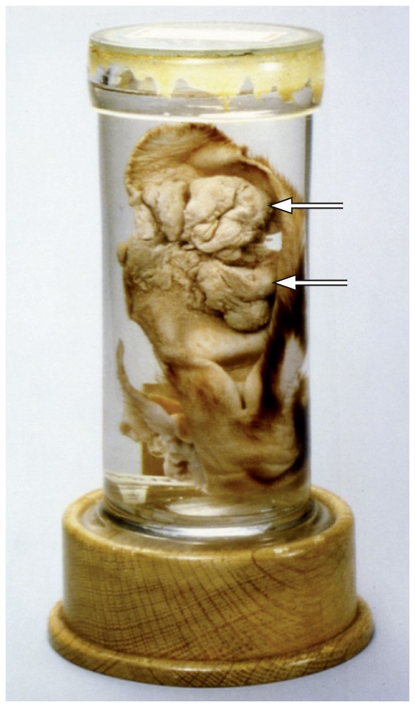
Figure 2.21b The Biology of Cancer (© Garland Science 2007)

Slide 34
Using animals…
Exposure to potential carcinogens in:
Food
Water
Air
By injection

Slide 35
Protection of animals
Today all federally funded research using animals is under strict guidelines to limit discomfort of the animal subjects.
All proposed research must be reviewed and approved by an Institutional Animal Use and Care Committee (IACUC)

Slide 36
Before grant proposals are considered, the institution must show they have established an IACUC.
Yearly reports from each institution are submitted to the federal IACUC organization, part of the US Department of Agriculture. USDA

Slide 37
What is considered?
Exposure to pain (how much, what kind, how long)
End point--duration
Surgery
Euthanasia
Number of animals needed for the study

Slide 38
The IACUC’s job is to decide whether the proposed experiments are important enough to use animals at all, and if so, if the number of animals needed is appropriate.
The IACUC must decide whether the exposure to pain/discomfort is warranted.

Slide 39
The IACUC is made of individuals from the scientists institution and community. It is a self-regulating organization.
Committee make-up
Scientists
Nonscientists (from the institution)
Non-scientists (from outside the institution)
Veterinarian

Slide 40
Minot State University’s IACUC
Dr. Super
Dr. Halloran
Dr. Deufel
Bill Harbort (MSU professor, not a scientist)
Ron Martin (community member)
Ron Thunshell (Veterinarian)
Heidi Peterson-—Nurse Practitioner, MSU student health.

Slide 41
We cannot hold a meeting without the veterinarian
The veterinarian can shut down the research without input from anyone.

Slide 42
US law requires that new chemicals be tested in animals before they are released for human use.
Components of cookware, clothing, construction materials…
Testing is not just for carcinogenicity---general health effects.

Slide 43
Next time…
Let’s return to mutagens/potential carcinogens…..Where do you start in showing experimentally something causes cancer?

